Slide 1

Amazon
Ankush Bihal

Slide 2
Amazon Prime Video Content Analytics: 1920-2021
Analyzing classic films and TV shows that are part of
Prime Video’s catalog, while data from 2006 onward
would directly pertain to Prime Video's own content.

Slide 3
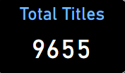
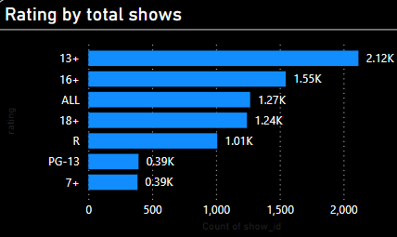

Titles and Rating

Slide 4


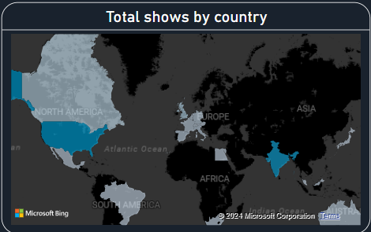
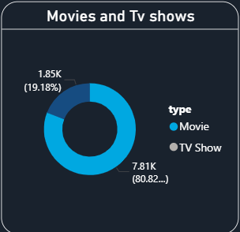
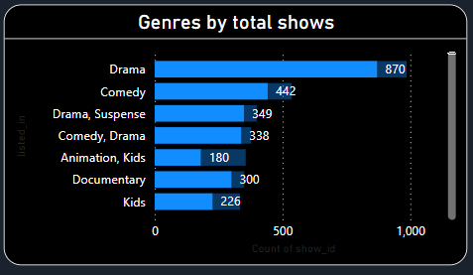
Total shows by country and genres

Slide 5
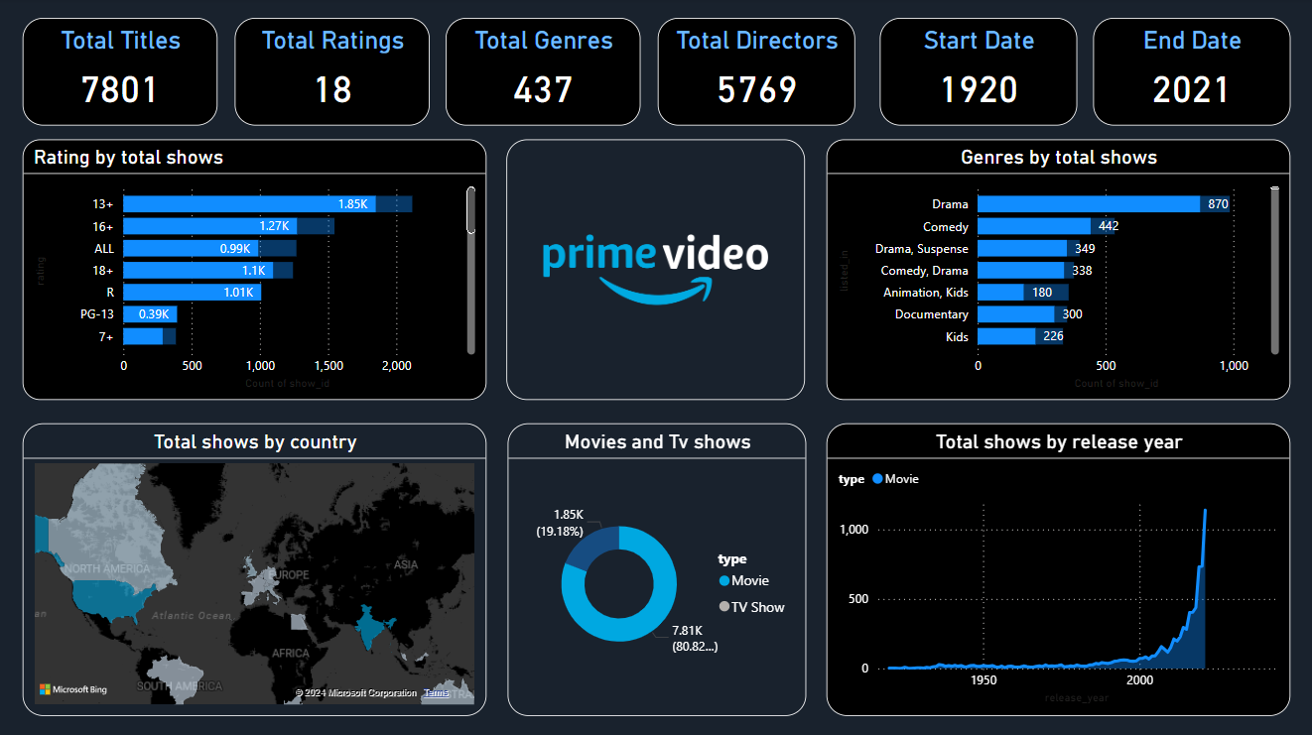

Slide 6
Thank You

